Slide 1

1
2
3
A
B
C
D

Slide 2


新课标高考英语7选5阅读理解备考
高中英语任务七选五阅读

Slide 3
一、高考大纲要求
阅读七选五主要考察学生的英语逻辑思维能力，也就是对上下文之间，层次之间逻辑关系的判断能力。
考查重点：主要考查考生对文章的整体内容和结构
以及上下文逻辑意义的理解和掌握。（细节）
选项特点：主旨概括句（文章整体内容）
过渡性句子（文章结构）
注释性句子（上下文逻辑意义）

Slide 4
解题步骤：
1.看标题、副标题和首尾段，预测文章大意
2.看选项，找出和文章相对应的关键词
3.通读全文，查看主题句，分析结构
4.看空前空后内容，分析之间的逻辑关系
5.灵活掌握答题顺序(先易后难)
6. 代入答案，重点核查逻辑关系。

Slide 5
七选五阅读理解题的解题技巧:
◆速读全文，关注每段首尾句，了解大意知主题
◆浏览选项，理解全篇逻辑关系,找出关键词
◆运用上下文所重复的关键词推断
◆利用同义词和近义词关系
◆利用词的上下义关系
◆利用反义词、过渡词关系
◆理清结构，确定答案，最后再来顺一遍

Slide 6
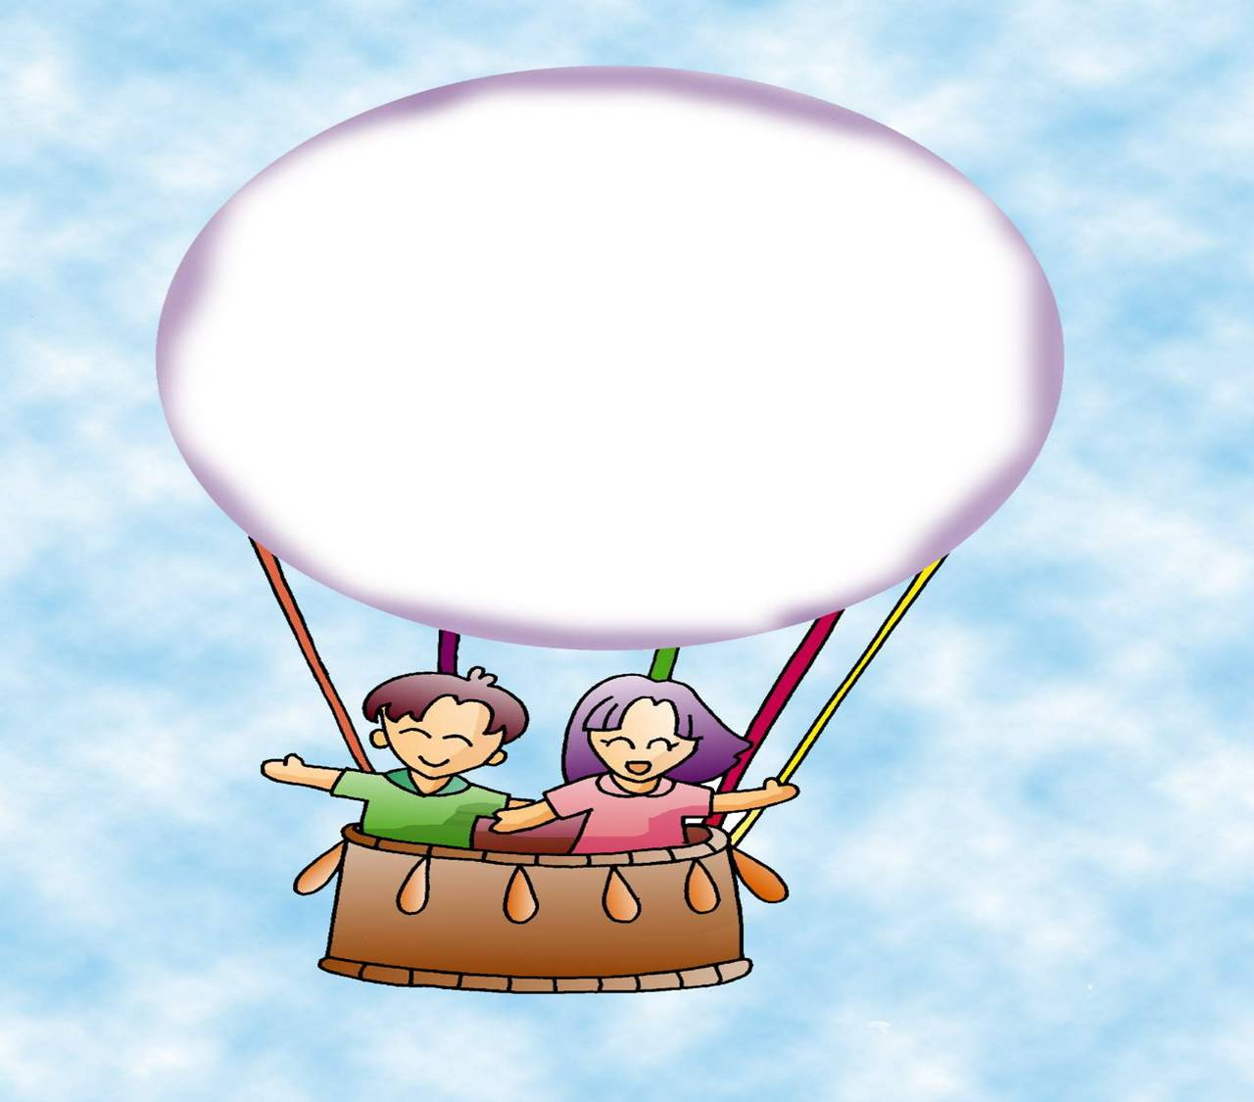
篇章结构类题解题方法

Slide 7
根据试题所在位置确定不同的解题策略
1)如果问题在段首或段落标题
通常是段落主题句。认真阅读后文内容，根据段落一致性原则，查找同义词或其他相关的词，推断出主题句。关注每段首尾句，了解大意知主题

Slide 8

总结下文，本段主题句
__74___ According to some psychologists , if parents are always telling a child that he or she is a fool or an idiot ,then the child is more likely to keep doing silly and foolish things. So it is probably better for parents to say very positive things to their children.
B . Parents should also be careful about what they say to young children
D. The children are then more likely to grow up bright and intelligent.

Slide 9
（P107）passage1第5题
5. A. Encourage Independence

Slide 10
Passage 4 Teletubbies is a very popular show featuring interesting and fun characters that keep children absorbed. __16__ Moreover, they are unique in their great contribution to preschoolers’ formal school readiness. The program fits well into the style of broadcasting that airs on PBS (Public Broadcasting Service), which is non-profit TV promoting high quality, educational programs without commercial interruption.
A company by the name of Ragdoll Productions in the United Kingdom developed the Teletubbies figures and their stories. Teletubbies’ producers, Anne Wood and Andrew Davenport, conducted extensive research to guarantee the effectiveness of their production as a teaching tool. __17__ The conclusions they reached were put very well into words by Ms. Wood when she said, “I want children to smile. If they are smiling, they will be relaxed. If they are relaxed, they will be confident. If they are confident, they will dare to be curious. If they are curious, they will grow in understanding.” __18__ Young children over the world are privileged to enjoy the benefits, for since 1992 the program has been sold to 92 broadcasters in 70 countries.

Slide 11
What exactly, though, makes Teletubbies so visibly and emotionally inviting to young children? The answer is that they are completely designed from their point of view, being plump(fat and rounded in a pleasant way) and innocent-faced, as well as playful, warm, and funny. __19__ Imagine a land that is part technological and part nursery rhyme. Their home is Tubbytronic Superdome, and they eat Tubby Toast and Custard. A windmill blows in wonderful surprises among rolling hills, talking flowers, and a smiling sun.
__20__ Teletubbies love each other very much; Teletubbies love to dance and sing; Teletubbies love their favorite things and interacting with their surroundings. These messages, conveyed in very basic, repetitive language, invite interaction with children, helping ages one through four expand the skills they need to watch and listen at the same time, which is key to the development of a child’s thinking abilities.

Slide 12
A. They live in a fascinating world that is brilliant and magical.
B. They interviewed young children, linguists, and nursery school teachers.
C. Lots of Teletubbies toys, books and DVDs are available to keep children entertained.
D. Although the program aims at children aged one to four, it appeals to older generations.
E. More importantly, the characters communicate very special, elementary ideas to the children.
F. Like other cartoon creatures, Teletubbies are colorful both in physical appearance and personality.
G. Much creative energy and innovation were channeled into each one of the 365 shows that’s been broadcast.

Slide 13
根据试题所在位置确定不同的解题策略
2)如果问题在段尾
A. 通常是结论、概括性语句。注意在选项中查找表示结果、结论、总结等的信号词，如therefore, as a result, thus, in short, to sum up, to conclude, in a word， finally, eventually等词语，选项中也可发现前文的同义词句。

Slide 14
Nowadays in China, parents care about their children’s education more than anything else. They spend a lot coaching(训练) their children in their studies. Some even hire teachers for their children. Many have their children sent to after-class schools.____.
It seems as if a better education is all that parents expect for their children.
Skills and knowledge means competition.
Skills and knowledge doesn’t mean all.
段尾

Slide 15
When you are going through a miserable experience,
you may hate the person who does this terrible thing to
you. Once the incident is over and some time has passed,
a person is usually able to release the feeling that has been
dominating his thoughts and emotions．_______________
A. The opposite of love is indifference.
It takes a great deal of energy to love or hate.
And eventually a feeling of indifference replaces the anger.
C

Slide 16
根据试题所在位置确定不同的解题策略
2)如果问题在段尾
B.也有可能是过渡性句子（承上启下）
（P107）passage1第1题
……Self-esteem building(自尊的培养) should start from young. Below are some tips to help you promote your children’s self-esteem.

Slide 17
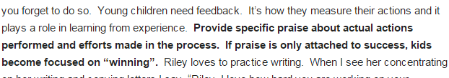

根据试题所在位置确定不同的解题策略
2)如果问题在段尾
C.可能是注释性句子
p107 passage1 第2题

Slide 18

3.选项如果出现在某个段落中间位置，则必须结合本段主题大意和它的前后两个句子的逻辑关系来判断。
P107 passage 2 第7题
1．Think of a good topic．
You most likely will be assigned to talk about a certain topic．If that‘s the case, you only need to make an outline and do some research．But in some cases, you will have to think of your own topic．Although it gives you more freedom to do it, thinking of a topic can be tricky（困难的）． 小题7: Or pick a topic that is timely and socially relevant．
D．Instead, make your audience smile, or burst into laughter at certain points in your discussion．
E．To make it easier, consider what will interest your audience．
F．It should summarize your whole talk in one sentence．
G．Don't be afraid of exploring the topic, as this will allow you to discover other points that need discussion．
并列关系

Slide 19

5）逻辑关系法（p103）
1)并列关系
2)层递关系（递进关系）
3)因果关系
4)转折让步关系
5)解释关系

Slide 20
1）并列关系：and, also, either…or…, neither…nor…, firstly, secondly, thirdly…. 等;
2）递进关系further, furthermore(而且，此外), moreover, what’s more（另外）, not only…but also,
3）因果关系：because , so, therefore, thus, accordingly(因此), as a result等
4）转折与让步关系：however, but， though, yet, in spite of, on the contrary,on the other hand, otherwise, while, rather than, even if, despite, unfortunately , fortunately等。

Slide 21
3）因果关系 P108 Passage4 第18题
…..If they are curious, they will grow in understanding. ___18______.Young children over the world are privileged to enjoy the benefits, for since 1992 the program has been sold to 92 broadcasters in 70 countries.
因果关系
G. Much creative energy and innovation were channeled into each one of the 365 shows that’s been broadcast.

Slide 22
P109 passage6 第29题
Focus on positive thoughts, relax the night before your test and reward yourself after the test is over. Often, people who suffer from exam anxiety cannot shut out negative thoughts or emotions about the test, and this can contribute to feeling more anxiety than normal. _29_____
因果关系
D. Understand that you are not alone and ask for help if necessary.
E. Remind yourself that it’s just one test and that you can get through it
F. Battling this type of performance anxiety can be hard, but it is not impossible.
G. Remind yourself to read the instructions carefully.

Slide 23
3.选项如果出现在某个段落中间位置，则必须结合本段主题大意和它的前后两个句子的逻辑关系来判断。
P107 passage 2 第7，8题
2．Make an outline for the lecture．
Start by listing down the points that you will discuss, and then fill in each point with subpoints．If necessary, make a research about your topic．小题8: But if in so doing you end up with a very long outline, figure how you can shorten the topic or cut where cutting is needed．
D．Instead, make your audience smile, or burst into laughter at certain points in your discussion．
F．It should summarize your whole talk in one sentence．
G．Don't be afraid of exploring the topic, as this will allow you to discover other points that need discussion．
转折关系

Slide 24
逻辑关系线索3
…This could be watching TV or listening to music. Doing some exercises earlier in the day should help you feel physically as well as mentally tired .
_______However, coffee or tea should be avoided as they contain caffeine and will keep you awake….
A. So, what’s a good sleep?
B. A bedtime drink can also help
C. Having a good sleep will keep you lively the whole day.
转折与让步关系：however, but， though, yet, in spite of, on the contrary,on the other hand, otherwise, while, rather than, even if, despite, unfortunately , fortunately等。

Slide 25
Fill in logical connections between sentences利用逻辑关系填空
Moreover
Your suggestion is thoughtful. ________, it is practical. _________, it is a good suggestion.
The village used to be very poor. ________, it has changed a lot since 1978.
Red is attractive. Many restaurants, ________, have red furniture or walls.
I didn’t go to the party with them. ________, I went to help an old lady with her housework.
In a word
However
therefore
Instead

Slide 26
根据试题所在位置确定不同的解题策略
1)如果问题在段首或段落标题
通常是段落主题句。认真阅读后文内容，根据段落一致性原则，查找同义词或其他相关的词，推断出主题句。关注每段首尾句，了解大意知主题
2)如果问题在段尾
A. 通常是结论、概括性语句。注意在选项中查找表示结果、结论、总结等的信号词，如therefore, as a result, thus, in short, to sum up, to conclude, in a word， finally, eventually等词语，选项中也可发现前文的同义词句。
B.也有可能是过渡性句子（承上启下）
C.可能是注释性句子

Slide 27
3.选项如果出现在某个段落中间位置，则必须结合本段主题大意和它的前后两个句子的逻辑关系来判断。

Slide 28
细节类题型解题技巧

Slide 29
1)词汇复现法
复现，是保证文章前后衔接而经常使用的一种写作手段，即作者在文章上下文不同的位置对同一个概念进行重复描述。复现关系，主要是指同义词复现、近义词复现、反义词复现等。
双保险：上下文再核实一下
P109 passage5 第23，24，25题

Slide 30
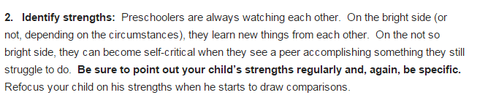
P107 passage1 第3题

Slide 31
image
______ The image includes the way you look, the way you act, the way you talk and the way you think. Interestingly, our self-images are often quite different from the images others hold about us.
Always love yourself.
Self-image is your own mind’s picture of yourself.
Don’t allow doubts to occur in it .
self-images
Self-image

Slide 32
…On the other hand ,the advantages of going overseas may include day-to- day opportunities to learn a new culture,meet new friends with whom you can use and practice the language,and chances to see different parts of the world.______Those disadvantages include expense,time away from one’s school,family,…
The following are its advantages.
However, there may be a number of disadvantages.
Consider a distance education.
Most of us are adapted to studying at school.

Slide 33
2)标点符号法
当祈使、陈述和疑问选项在所列选项中同时出现，你可以在选项中通过上下文或陈述或疑问语气快速找到达到语义衔接的选项，从而达到快而准的目的。

Slide 34
Do you know what a big dream is ? 1 Or, is a big dream something that provides only entertainment? Children dream big dreams ,but there …
?
?
Family and friends
How big dreams die?
Does a big dream show one’s future?
They simply fail until they succeed
?

Slide 35
3)代词线索法
英语表达中代词出现的频率极高，代词的作用无非是指代前面提及的名词或句子，巧妙利用这样的指代关系和根据代词的单复数差异可以准确而快速地解题。
Passage 4 第17和19题

Slide 36
Teletubbies is a very popular show featuring interesting and fun characters that keep children absorbed. __16__ Moreover, they are unique in their great contribution to preschoolers’ formal school readiness. The program fits well into the style of broadcasting that airs on PBS (Public Broadcasting Service), which is non-profit TV promoting high quality, educational programs without commercial interruption.
A company by the name of Ragdoll Productions in the United Kingdom developed the Teletubbies figures and their stories. Teletubbies’ producers, Anne Wood and Andrew Davenport, conducted extensive research to guarantee the effectiveness of their production as a teaching tool. __17__ The conclusions they reached were put very well into words by Ms. Wood when she said, “I want children to smile. If they are smiling, they will be relaxed. If they are relaxed, they will be confident. If they are confident, they will dare to be curious. If they are curious, they will grow in understanding.” __18__ Young children over the world are privileged to enjoy the benefits, for since 1992 the program has been sold to 92 broadcasters in 70 countries.

Slide 37
What exactly, though, makes Teletubbies so visibly and emotionally inviting to young children? The answer is that they are completely designed from their point of view, being plump(fat and rounded in a pleasant way) and innocent-faced, as well as playful, warm, and funny. __19__ Imagine a land that is part technological and part nursery rhyme. Their home is Tubbytronic Superdome, and they eat Tubby Toast and Custard. A windmill blows in wonderful surprises among rolling hills, talking flowers, and a smiling sun.
__20__ Teletubbies love each other very much; Teletubbies love to dance and sing; Teletubbies love their favorite things and interacting with their surroundings. These messages, conveyed in very basic, repetitive language, invite interaction with children, helping ages one through four expand the skills they need to watch and listen at the same time, which is key to the development of a child’s thinking abilities.

Slide 38
A. They live in a fascinating world that is brilliant and magical.
B. They interviewed young children, linguists, and nursery school teachers.
C. Lots of Teletubbies toys, books and DVDs are available to keep children entertained.
D. Although the program aims at children aged one to four, it appeals to older generations.
E. More importantly, the characters communicate very special, elementary ideas to the children.
F. Like other cartoon creatures, Teletubbies are colorful both in physical appearance and personality.
G. Much creative energy and innovation were channeled into each one of the 365 shows that’s been broadcast.

Slide 39
代词线索 （2014全国课标卷）
Try taking these four steps. the next time you are stressed:
(1) Get support. When you need help, reach out to the people who care about you. Talk to “trusted adult, such as “parent or other relatives. 72 They might have had similar problems, such as dealing with a test, or the death of a beloved pet.
D. Ah, it feels so good when the stress is gone.
E. You need to figure out what the problem is.
F. And don't forget about your friends.

Slide 40


___73___ They say the first step is to admit that you are angry and to recognize the real cause of the anger,…
A. Doctors say the solution is learning how to deal with anger.
B. He said that laughter is much healthier than anger.
C. Anger is a normal emotion that we all feel from time to time.

Slide 41
4)时间关系：at first, at last, finally, first, firstly, in the first place, to start with，in the mean time, last, later, next, second, secondly, then, third, thirdly, to begin with以及一些具体的时间。

Slide 42
Sixty years ago
Sixty years ago, people asked about your astrological sign. ________ These days, having a web address is almost as important as a street address.
Start simply.
Nowadays, they want to know your website.
At the top of the page is a banner Graphic.
Nowadays

Slide 43
逻辑关系线索3
…This could be watching TV or listening to music. Doing some exercises earlier in the day should help you feel physically as well as mentally tired .
_______However, coffee or tea should be avoided as they contain caffeine and will keep you awake….
A. So, what’s a good sleep?
B. A bedtime drink can also help
C. Having a good sleep will keep you lively the whole day.
转折与让步关系：however, but， though, yet, in spite of, on the contrary,on the other hand, otherwise, while, rather than, even if, despite, unfortunately , fortunately等。

Slide 44
The differences are everywhere. _____________
But different cultures make the world of 21st century more colorful. The cultural gap should not be the obstacle (障碍) to the civilization of human being. It ought to be the motivation of our going farther.
E This is because the culture systems are two separate systems on the whole.
F. They helped the two cultures develop for centuries and form their own styles.
G. They are obvious and affect people's ways of thinking and their views of the world.

Slide 45
逻辑关系线索1
It seems urgent that communications in transport should be improved. ____ All over cities, it seems that people are too tired and too rushed to be polite.
Communication between human beings
should also be kept smooth and polite.
B.Yet this is all too often seen.
C.The public should obey the rules.
also
并列与递进关系：and, also, either…or…, neither…nor…, firstly, secondly, thirdly…. 等;
further, furthermore(而且，此外), moreover, what’s more（另外）, not only…but also,

Slide 46
逻辑关系线索2
because
…_________ Some choose it because of their religious beliefs. Others say it provides more time for the family to be together. They say home offers a better place for learning. Some parents….
A. So a number of parents began home-schooling
B. Home –schooling is not accepted by all the people
C. Parents choose home –schooling for several reasons
因果关系：because , so, therefore, thus, accordingly(因此), as a result等

Slide 47

summary
1. 看代词或冠词。it, they, this, the…
2. 看空前，空后的逻辑关系（conj）
however, but, so, though, also ...
3. 看本段主题做题。
4. 相似元素最多，相关性最强。
同义词/近义词/的重复使用
同一词根，不同词性的单词
5.看行文逻辑是否完整全面
七选五策略

Slide 48
福利来啦！Practice makes perfect!
B
__________________. Some bedrooms only whisper it through a handful of clues such as framed photos scattered about. Others say much more, with dozens of items illuminating the lives of those who live there.
Every bedroom is different.
Every bedroom tells a story.
Bedrooms are decorated with different items.

Slide 49
Psychologists think there may be many reasons why violent games are more harmful to children than violent movies. Firstly, players are actively involved in violence, and may begin to use weapons as second nature._________
A. Children are most likely to become addicted
to violent videogames.
B. At least 12 murders since 1997 have been
linked to an addiction with violent video
games.
C. Secondly, violent games provide repetitive aggressive experiences that are rewarded by more killing.
Firstly
Secondly

Slide 50
C
The gift was a thoughtful one. _____________. And the fugitive（逃跑的） fish liked their new digs a little too much. The bluegill entered Japan’s waterways, eating the …
It was a great plan.
It was difficult to solve the problem.
However, somehow the bluegill escaped.

Slide 51
Over the last 25 years, British society has changed a great deal – or at least many parts of it have. ______________ . Ideas about social class – whether a person is “working - class” or “middle - class” – are one area in which changes have been extremely slow.
A．Nowadays, a great deal has changed
B．As a result, differences in life – styles and attitudes came into existence
C．In some ways, however, very little has changed, particularly where attitudes are concerned

Slide 52

…That happens in the 1980s. And, most recently, she says many kinds of people have joined the movement.________They represent many races,regions and political beliefs.
They are mainly rich people
Parents choose home—schooling for several reasons.
Most often,their parents are their teachers.
She says these include rich people and poor people.

Slide 53
Taking good notes is a time saving skill that will help you to become a better student in several ways.__________ Second, your notes are excellent materials to refer to when you are studying for a test. Third, note-taking offers….
Second
You must write your notes on separate paper.
Use words, not complete sentences .
First,the simple act of writing something down makes it easier for you to understand and remember.
There are three practical note-taking methods.

Slide 54
You and your friends are leaving a concert on a Friday night. When you get outside, your ears are ringing. You have to shout to be heard. ____________________ . So no harm done…right?
A. If the answer is yes, your music is too loud.
B. But by morning, your hearing is totally back to normal.
C. Unfortunately, there’s no way to get back hearing you’ve already lost.

Slide 55
Good Luck

