Slide 1
主旨大意题
事实细节题
阅读四大题型
猜测词义题
推理判断题

Slide 2
Questions for details in
reading comprehension

Slide 3
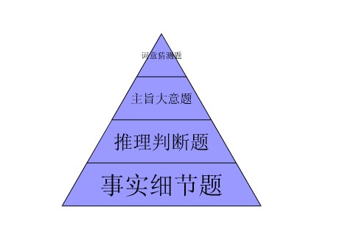
高考英语阅读理解题考查方式与比重

Slide 4
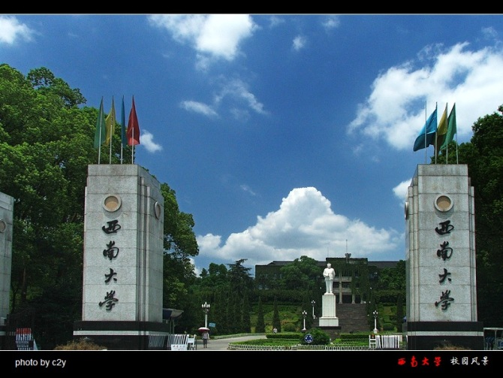
(The first reading material)
What should we prepare for our college life?

Slide 5
Tuition Fees(学费)
Tuition fees are different from department to department，generally from 5000 to 6000 a year. For further information：tui@xihu-University.com
Accommodation(住宿)
You can have a room in a 4­ bedroom flat，which will cost about 100 a month with other regular living costs of about 100 a month for one person. For further information：tui@xihu-University.com

Slide 6
You have to pay at least ________a year if you study at the University of XIHU.

Slide 7
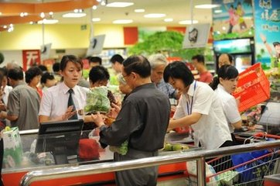
( The second reading material)
What's your feeling about buying something in the supermaket?

Slide 8
People can use a home computer to make their shopping lists. Once at the supermarket，you can use a customer card to start a system(系统)that will organize the trip around the store. If you're looking for toothpicks，you type in the word or pick it from a list，and a map will appear on the screen showing where you are and where you can find them.
The devices also keeps a record of what you buy. When you've finished，the device figures out your bill. Then you go to the checker or place your card into a self­checkout stand and pay.

Slide 9
Put each thing in right order.
a．Start the system.
b．Make a shopping list.
c．Find the things you want.
d．Go to a self­checkout stand.

Slide 10
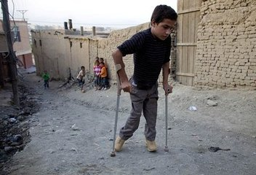
(The third reading material)
Do you know one kind of the disease called---polio['pəʊlɪəʊ]?

Slide 11
Born in 1907 in a village near Mexico City, Karl suffered from polio (小儿麻痹症) at the age of seven. Her spine(脊柱) became bent as she grew older. Then, in 1925, her back was broken in several places in a schoolbus accident.Throughout the rest of her life, the artist had many operations, but nothing was able to cure the terrible pain in her back. However, the accident had an unexpected side effect. While lying in her bed recovering, Karl taught herself to paint.

Slide 12
The terrible pain Karl suffered was caused by ________.(what)

Slide 13
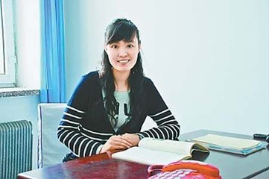
(The fourth reading material)
Do you know the lady? And her story?

Slide 14
The most beautiful teacher "Zhang Lili" has moved thousands of people in China. On the evening of May 8th , 2012 , the students went home after school as usual. When they
passed a bus , the bus started to move towards them because of the driver's mistake .To
save the students , Miss Zhang pushed them
away but she was hit by the bus and lost her
legs She has been in hospital so far. Teacher'
love is great, best wishes to all the teachers.

Slide 15
Whose fault leads to Zhang Lili’ tragedy? (________)

Slide 16
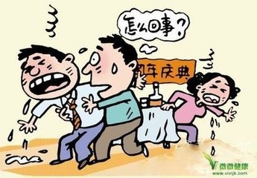
( The fifth reading material)
Have you ever heard the food poisoning accident?

Slide 17
Food sometimes gets poisoned with harmful things. A person who eats such food can
get an illness called foodpoisoning. Food
poisoning is usually not serious, but some
types are deadly. The symptoms of food
poisoning usually begin within hours of
eating the poisoned food. Fever is one of
the most common symptoms.

Slide 18
From the passage we know that:
"Food poisoning means death."
Is there anything wrong?

Slide 19
Discussion:
What kind of questions will the detail reding exercise focus on?
1.
2.
3.
4.
5.
the number(s)
the order(s)
the thing(what)
the people(who)
the special sentece

Slide 20
exercise
The human body is a living machine, and like all machines, it needs fuel to supply it with energy. That is the food we eat. But how much do we need to stay healthy? The energy value of food is usually measured in calories. A calorie is the amount of heat required to raise the temperature of 1kg of water by 1℃. The number of calories people need per day is different, as the chart shows……
练习题
CALORIES NEEDED A DAY
Baby 750 | Office worker 2,700
Child aged 8 2,100 | Woman feeding baby 2,700
Man over 70 2,100 | Boy aged 16 3,000
Woman 3,600 | Farmer 2,600

Slide 21
Q1) ____ calories are required to raise the temperature of 5kg of water from 35℃to 90℃.
A. 55 B. 175 C. 325 D. 275
文章
Q2) Which statement is TRUE according to the chart above?
A. A child aged 8 requires more than 3 times the amount of calories that a baby does.
A boy aged 16 requires nearly twice the amount of calories that a boy aged 8 does.
An office worker requires the same amount of calories per day as a woman feeding a baby does.
A farmer requires nearly 1.5 times the amount of calories that an office worker does.

