Slide 1

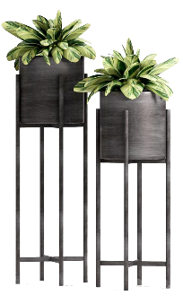
读
后
续
写
公
开
课

Slide 2
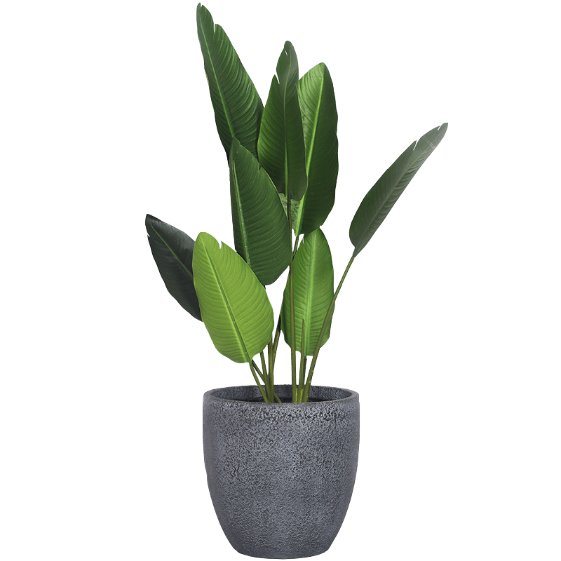
1
如何构思续写的内容
目录
2
读后续写的高分攻略

Slide 3
读后续写的具体要求
提供一段350词以内的语言材料，要求考生依据该材料内容、所给段落开头语和所标示关键词进行续写（150词左右），将其发展成一篇与给定材料有逻辑衔接、情节和结构完整的短文。

Slide 4
1
如何构思续写的内容
Step 1
Read for
elements
Step 2
Read for
plots
Step 3
Gather
ideas
Step 4
Make predictions

Slide 5
阅读下面短文，根据所给情节进行续写，使之构成一个完整的故事。
Steve was the most amazing person in all of Minneapolis, and he was my cousin. By the age of 19, Steve was a star baseball player at the University of Minnesota. I wanted to be exactly like him. So when Steve asked me to go with him on a spring fishing trip in northern Minnesota, I was excited!
After planning the trip, we gathered clothes and supplies, and began our great adventure. We reached the Superior National Forest in northern Minnesota by early evening. On our way to the campsite, Steve pointed to a small house faraway in one of the mountains, saying that it was the ranger station (护林站) where the forester worked.

Slide 6
Finally, after a long walk, we reached the campsite and set up the camp as the sun was setting. Steve knew all the tricks of an experienced wilderness camper. After we gathered enough wood from the forest, he started the campfire using only stone and steel — no matches. For supper we feasted on freeze-dried beef, wild rice and pea soup. I ate greedily after all that work.
Tired enough, we climbed into our sleeping bags early and talked about our plans for fishing the next day. We were still talking quietly when a sudden north wind picked up; the temperature dropped and it began to snow. Steve found a way to increase the temperature inside the tent. He dragged a log from the forest to the opposite side of the campfire. Then he wrapped aluminum foil (铝箔) around the log. The heat from the fire reflected off the foil and into the tent. Soon images of lake fish were filling my dreams.

Slide 7
The snow had stopped, but sometime later a powerful wind must have kicked up the flames of our dying fire. I was suddenly awakened by Steve. Our tent was on fire. Frightened, I ran out of the tent immediately. The tent collapsed (倒塌) with Steve inside. Without any thought of endangering myself, I reached into the burning tent and pulled him to the icy lake. Fortunately, we were not seriously hurt.
注意:
1. 所续写短文的词数应为 150 左右；
2. 至少使用 5 个短文中标有下划线的关键词语；
3. 续写部分分为两段，每段的开头语已为你写好；
4. 续写完成后，请用下划线标出你所使用的关键词语。

Slide 8
Paragraph 1:
Later, as we stood by the burning tent to keep warm, we considered our difficult situation. _______________________________________
_________________________________________________________
_________________________________________________________
Paragraph 2:
Suddenly, we heard a noise in the forest. _____________________
_________________________________________________________
_________________________________________________________

Slide 9
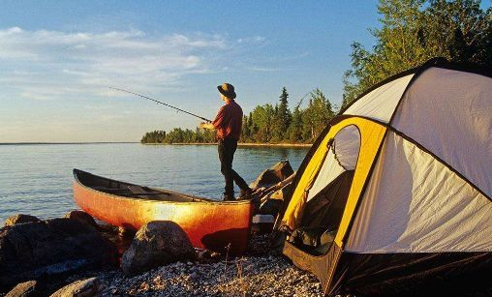
Step 1 Read for elements

Slide 10
Elements
What
An adventurous fishing trip
Who
I, Steve, forester
When
In spring
Where
In a forest

Slide 11
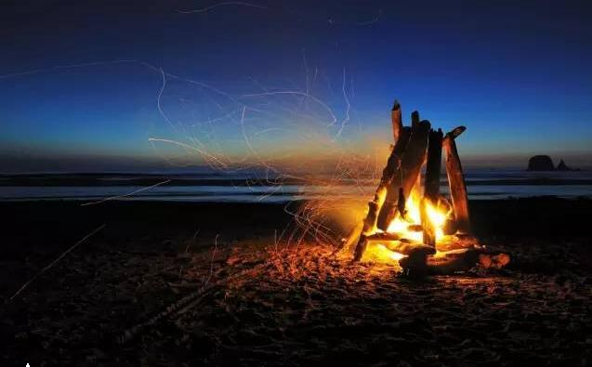
Step 2 Read for plots

Slide 12
Climax
(the main problem or conflict)
Process
Story Mountain
?
Beginning
(character and setting)
Ending
(a time to solve the problem
/ how things end up)

Slide 13

1. Steve asked me to go on a spring fishing trip.
2. We reached the campsite and set up the camp.
3. Our tent was on fire and we escaped to
the icy lake.
4. ?
?
3
Ending
2
Climax
1
Process
Beginning

Slide 14
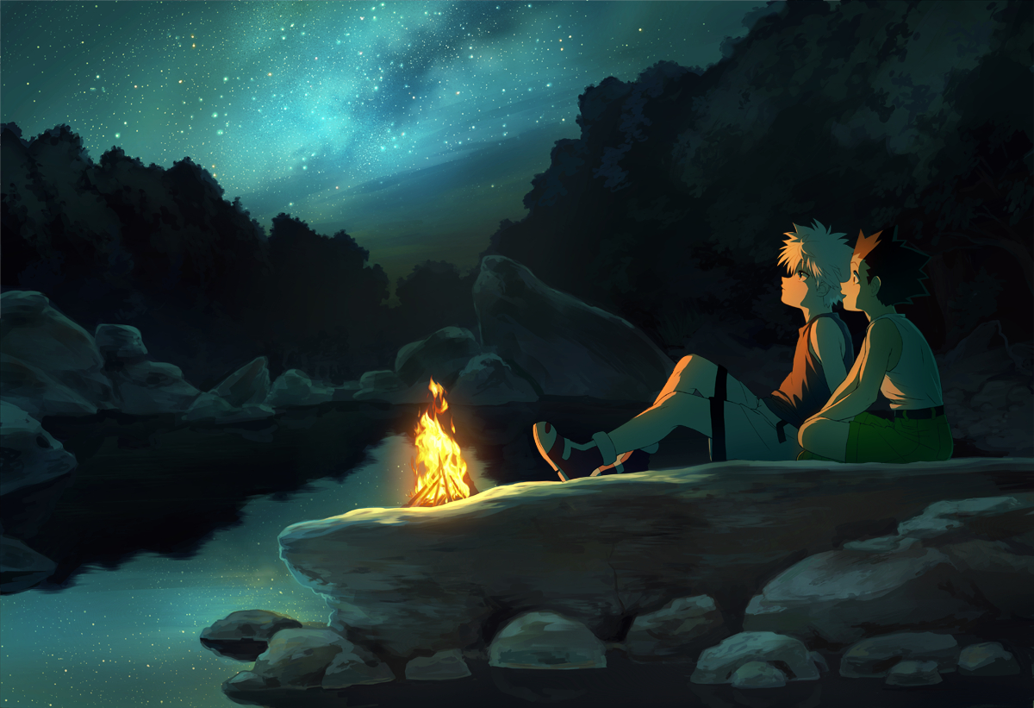
Step 3 Gather ideas

Slide 15
Setting (time / place) | Time: spring Place: Superior National Forest in northern Minnesota
Characters | I, Steve, forester
Plot | Steve asked me to go on a spring fishing trip.
Problem | Our tent was on fire.
Ending
?

Slide 16
信息整理：
体裁：记叙文
时态：一般过去时
原文核心信息解读：“我”和表哥去森林里露营，夜里下起了雪，天很冷，表哥生起了篝火，“我们”在温暖中入睡了。睡着后，帐篷起火了，“我们”匆忙逃了出来，但帐篷烧毁了……

Slide 17
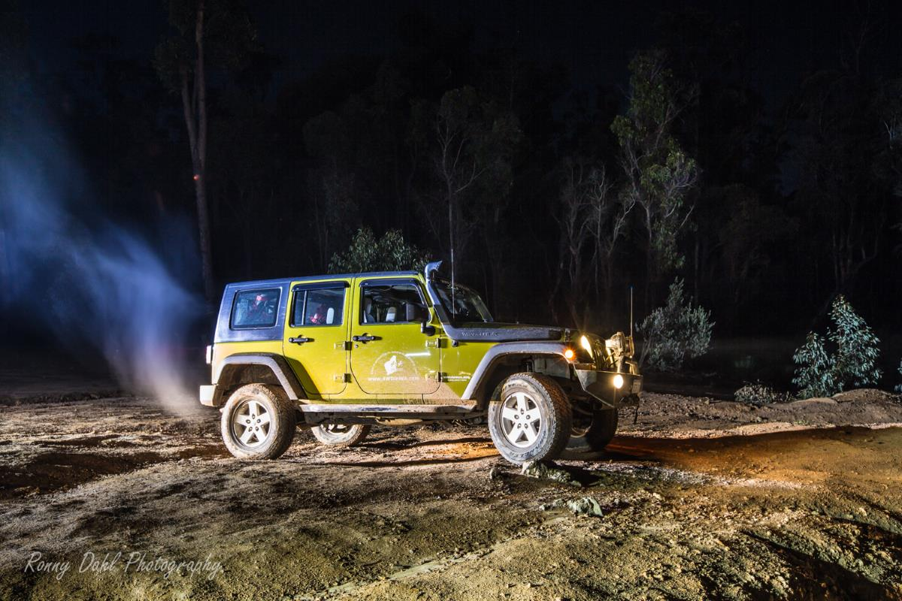
Step 4 Make predictions

Slide 18
高考新题型“读后续写”英文教学公开课(共42张PPT)
可用于续写的已知信息：
划线词 | Character | Steve, forester
 | Setting | clothes, supplies, campsite, forest, fire
 | Action | found, endangering
 | Mood | frightened
段首句 | Para. 1: Later, as we stood by the burning tent to keep warm, we considered our difficult situation. (续写部分可详细描写具体困境，比如衣服等物品烧毁，在森林中远离人烟，无法求助等。) Para. 2: Suddenly, we heard a noise in the forest. (续写部分可写声音的来源，发出声音者可以是提供救助的人。)
高考新题型“读后续写”英文教学公开课(共42张PPT)

Slide 19
高考新题型“读后续写”英文教学公开课(共42张PPT)
写作思路：
“我们”在荒芜人烟的森林深处，孤立无援，随身物品也都随着帐篷一起烧毁了，正当不知道该怎么办的时候，林中传来了声响，发现是护林人开着车过来了。原来护林人看到了火光，过来一探究竟，结果“我们”得救了。
构思的理由：
文章中出现过forester (护林人)，这是极其有用的信息，另外根据常识可知，护林人最重要的工作之一就是侦查火情，所以森林中有火情的话，护林人一定会一探究竟。
高考新题型“读后续写”英文教学公开课(共42张PPT)

Slide 20
高考新题型“读后续写”英文教学公开课(共42张PPT)
One possible version:
Paragraph 1:
Later, as we stood by the burning tent to keep warm, we considered our difficult situation. Our campsite was in the deep of the forest, really far away from the highway. We were in the middle of nowhere, wearing only underwear, with our supplies burnt into ashes, including our cellphones. Even Steve was unsure what to do next. The only thing we could do was just sit in the cold air and wonder how to get out of the forest.
高考新题型“读后续写”英文教学公开课(共42张PPT)

Slide 21
高考新题型“读后续写”英文教学公开课(共42张PPT)
Paragraph 2:
Suddenly, we heard a noise in the forest. Anxiously we listened and stared into the darkness. A jeep appeared. A forester had spotted the light from the fire and had come to have a check. We jumped into the warm vehicle and the forester drove us to the ranger station, where we were given clothes and were able to call our parents. Steve and I had many more camping adventures from then on, but it was on this trip that Steve began to treat me more like a friend rather than a younger cousin. Our friendship continues to this day.
高考新题型“读后续写”英文教学公开课(共42张PPT)

Slide 22
高考新题型“读后续写”英文教学公开课(共42张PPT)
2
读后续写的高分攻略
第五档：21分-25分
第四档：16分-20分
第三档：11分-15分
第二档：6分-10分
第一档：1分-5分
评
分
标
准
高考新题型“读后续写”英文教学公开课(共42张PPT)

Slide 23
高考新题型“读后续写”英文教学公开课(共42张PPT)
第五档： 21分-25分
与所给短文融洽度高，与所提供各段落开头语衔接合理。
内容丰富，应用了5个以上短文中标出的关键词语。
所使用语法结构和词汇丰富，准确，可能有些许错误，但完全不影响意义表达。
有效地使用了语句间的连接成分，使所续写短文结构紧凑。
高考新题型“读后续写”英文教学公开课(共42张PPT)

Slide 24
高考新题型“读后续写”英文教学公开课(共42张PPT)
第四档： 16分-20分
与所给短文融洽度较高，与所提供各段落开头语衔接较为合理。
内容比较丰富，应用了5个以上短文所标出的关键词语。
所使用的语法结构和词汇较为丰富、准确，可能有些许错误，但不影响意义表达。
比较有效地使用了语句间的连接成分，使所续写短文结构紧凑。
高考新题型“读后续写”英文教学公开课(共42张PPT)

Slide 25
高考新题型“读后续写”英文教学公开课(共42张PPT)
第三档（11分-15分）
与所给短文关系较为密切，与所提供各段落开头语有一定程度的衔接；
写出了若干有关内容，应用了4个以上短文中标出的关键词语；
应用的语法结构和词汇能满足任务的要求，虽有一些错误，但不影响意义的表达；
应用简单的语句间的连接成分，使全文内容连贯。
高考新题型“读后续写”英文教学公开课(共42张PPT)

Slide 26
高考新题型“读后续写”英文教学公开课(共42张PPT)
第二档（6分-10分）
与所给短文有一定的关系，与所提供各段落开头语有一定程度的衔接；
写出了一些有关内容，应用了3个以上短文中标出的关键词语；
语法结构单调、词汇项目有限，有些语法结构和词汇方面的错误，影响了意义的表达；
较少使用语句间的连接成分，全文内容缺少连贯性。
高考新题型“读后续写”英文教学公开课(共42张PPT)

Slide 27
高考新题型“读后续写”英文教学公开课(共42张PPT)
第一档（1分-5分）
与所给短文和开头语的衔接较差；
产出内容太少，很少使用短文中标出的关键词语；
语法结构单调、词汇项目很有限，有较多语法结构和词汇方面的错误，严重影响了意义的表达；
缺乏语句间的连接成分，全文内容不连贯。
高考新题型“读后续写”英文教学公开课(共42张PPT)

Slide 28
高考新题型“读后续写”英文教学公开课(共42张PPT)
续写中常出现的问题
一、书写潦草，卷面涂改；
二、上下文的连贯性差；
三、错词错句多，好词好句少；
四、没有丰富和生动的细节推动情节的发展；
五、与所给短文及段落开头语的衔接程度差；
六、没有使用5个或5个以上原文中的划线词语，没有划出所
用的划线词语。
高考新题型“读后续写”英文教学公开课(共42张PPT)

Slide 29
高考新题型“读后续写”英文教学公开课(共42张PPT)
获得高分的写作技巧
Tip 1: 故事要围绕着主要人物展开。
Tip 2: 详细刻画角色及其情感。
Tip 3: 使用恰当的衔接词以使故事更有连贯性。
Tip 4: 使用恰当的修饰词以使描写更加生动。
Tip 5: 做到首尾呼应以使故事更加有条理。
Tip 6: 确保第二段和第一段的衔接有逻辑。
高考新题型“读后续写”英文教学公开课(共42张PPT)

Slide 30
高考新题型“读后续写”英文教学公开课(共42张PPT)
示例
阅读下面短文，根据所给情节进行续写，使之构成一个完整的故事。(2016年10月浙江高考试题)
One weekend in July, Jane and her husband, Tom, had driven three hours to camp overnight by a lake in the forest. Unfortunately, on the way an unpleasant subject came up and they started to quarrel. By the time they reached the lake, Jane was so angry that she said to Tom, “I’m going to find a better spot for us to camp” and walked away.
With no path to follow, Jane just walked on for quite a long time. After she had climbed to a high place, she turned
高考新题型“读后续写”英文教学公开课(共42张PPT)

Slide 31
高考新题型“读后续写”英文教学公开课(共42张PPT)
around, hoping to see the lake. To her surprise, she saw nothing but forest and, far beyond, a snowcapped mountain top. She suddenly realized that she was lost.
“Tom!” she cried. “Help!”
No reply. If only she had not left her mobile phone in that bag with Tom. Jane kept moving, but the farther she walked, the more confused she became. As night was beginning to fall, Jane was so tired that she had to stop for the night. Lying awake in the dark, Jane wanted very much to be with Tom and her family. She wanted to hold him and tell him how much she loved him.
Jane rose at the break of day, hungry and thirsty. She could
高考新题型“读后续写”英文教学公开课(共42张PPT)

Slide 32
高考新题型“读后续写”英文教学公开课(共42张PPT)
hear water trickling (滴落) somewhere at a distance. Quickly she followed the sound to a stream. To her great joy, she also saw some berry bushes. She drank and ate a few berries. Never in her life had she tasted anything better. Feeling stronger now, Jane began to walk along the stream and hope it would lead her to the lake.
As she picked her way carefully along the stream, Jane heard a helicopter. Is that for me? Unfortunately, the trees made it impossible for people to see her from above. A few minutes later, another helicopter flew overhead. Jane took off her yellow blouse, thinking that she should go to an open area and flag them if they came back again.
高考新题型“读后续写”英文教学公开课(共42张PPT)

Slide 33
高考新题型“读后续写”英文教学公开课(共42张PPT)
注意：
1.所续写短文的词数应为150左右；
2.应使用5个以上短文中标有下划线的关键词；
3.续写部分分为两段，每段的开头语已为你写好；
4.续写完成后，请用下划线标出你所使用的关键词语。
Paragraph 1：
But no more helicopters came and it was getting dark again. _______________________________________
_____________________________________________
Paragraph 2：
It was daybreak when Jane woke up. _____________
_____________________________________________
高考新题型“读后续写”英文教学公开课(共42张PPT)

Slide 34
高考新题型“读后续写”英文教学公开课(共42张PPT)
The underlined words
Character: Tom, Jane
Setting: yellow house, stream, lake, helicopter, at
a distance
Action: walked, climbed
Mood: to her great joy
高考新题型“读后续写”英文教学公开课(共42张PPT)

Slide 35
高考新题型“读后续写”英文教学公开课(共42张PPT)
Climax
看见直升飞机
(helicopters)
Process
confused，tired
lost 迷路
quarrel
吵架，生气离开
rescued?
被救？
angry
Beginning
Ending
高考新题型“读后续写”英文教学公开课(共42张PPT)

Slide 36
高考新题型“读后续写”英文教学公开课(共42张PPT)
构思
细读两段续写的开头语，理顺续写段落的逻辑关系；
围绕划定的10个关键词，合理创新故事情节。
Para. 1: But no more helicopters came and it was dark.
续写部分：简当时的感受？
简是如何过夜的？
简睡着了吗？
Para. 2: It was daybreak when Jane woke up.
续写部分：简获救了吗？
谁救了简？
怎么救的？
她当时的感受？
高考新题型“读后续写”英文教学公开课(共42张PPT)

Slide 37
高考新题型“读后续写”英文教学公开课(共42张PPT)
注意
一、所续写短文的词数应为150左右（词数少于130的，
从总分中减去2分）；
二、应使用5个以上短文中标有下划线的关键词语，少用1
个扣1分，少用2个扣2分，少用3到4个扣3分；
三、续写完成后，请用下划线标出你所使用的关键词语，
少划1个不扣分，少划2个到3个扣1分，少划4个扣2分。
高考新题型“读后续写”英文教学公开课(共42张PPT)

Slide 38
高考新题型“读后续写”英文教学公开课(共42张PPT)
第五档续写例文
But no more helicopters came and it was getting dark again. Feeling disappointed, Jane had to stay alone for another night. After walking a long distance again, it occurred to her that she had a box of matches with her. She was wild with joy and used them to burn some branches so that she could get some warmth. Staring at the jumping fire, Jane thought of all the things that she and Tom had experienced together. Only in this way could Jane feel better and fall asleep.
高考新题型“读后续写”英文教学公开课(共42张PPT)

Slide 39
高考新题型“读后续写”英文教学公开课(共42张PPT)
It was daybreak when Jane woke up. Feeling refreshed, she continued to walk along the stream to find the way out. At noon, to her great joy, she finally caught sight of a wide water surface at a distance. It was the lake! Also she spotted a crew of policemen seeking along the bank! It seemed that they also spotted her because they were moving towards her! It was Tom who called the police. Finally, they led her to her husband. And the minute they met, they hugged together firmly as if they would never separate again. They got home and have led a happy life ever since.
高考新题型“读后续写”英文教学公开课(共42张PPT)

Slide 40
高考新题型“读后续写”英文教学公开课(共42张PPT)
【点评】
该文为最高档五档作文22分。
第一、续写部分和原文及首句的融合度高。第一段开头Jane had to stay alone for another night一句中的another night说明作者理解了原文中Jane已经度过了一夜的事实，又为下文她睡着了埋下了伏笔，从而和第二段又衔接上了。第二段开头作者说，Jane感觉精力恢复了，与段首所说的醒来呼应。
高考新题型“读后续写”英文教学公开课(共42张PPT)

Slide 41
高考新题型“读后续写”英文教学公开课(共42张PPT)
【点评】
第二、该文内容丰富。增加了a box of matches和jumping fire，极有画面感；同时，在第二段，Jane看到了平静的湖面、警方的活动和他们见面后的喜悦等细节都描写得很生动。另外，在情节的推进方面，作者在第一段续写“生火”和第二段续写的开头“继续前行”使故事复杂化，然后完成故事（看到湖面、警察和Tom）。
高考新题型“读后续写”英文教学公开课(共42张PPT)

Slide 42
高考新题型“读后续写”英文教学公开课(共42张PPT)
【点评】
第三、该文基本没有语言错误，达到了语法和词汇的准确性；在词汇和语法的丰富性上，作者使用了occur，wild with joy，refresh，caught sight of，spot，the minute等词汇；在语法结构上，作者使用了现在分词feeling disappointed，staring at the jumping fire，主语从句it occurred to her that和it seemed that，as if 引导的状语从句，倒装only in this way could Jane...，在续写中体现出了较高的语言运用水平。最后，在连贯性方面，作者使用了and，also，after等词将上下文的逻辑体现了出来。
高考新题型“读后续写”英文教学公开课(共42张PPT)

