Slide 1
Unit 1 Food matters
Extended reading
王爱娟 湖南省茶陵县第三中学

Slide 2
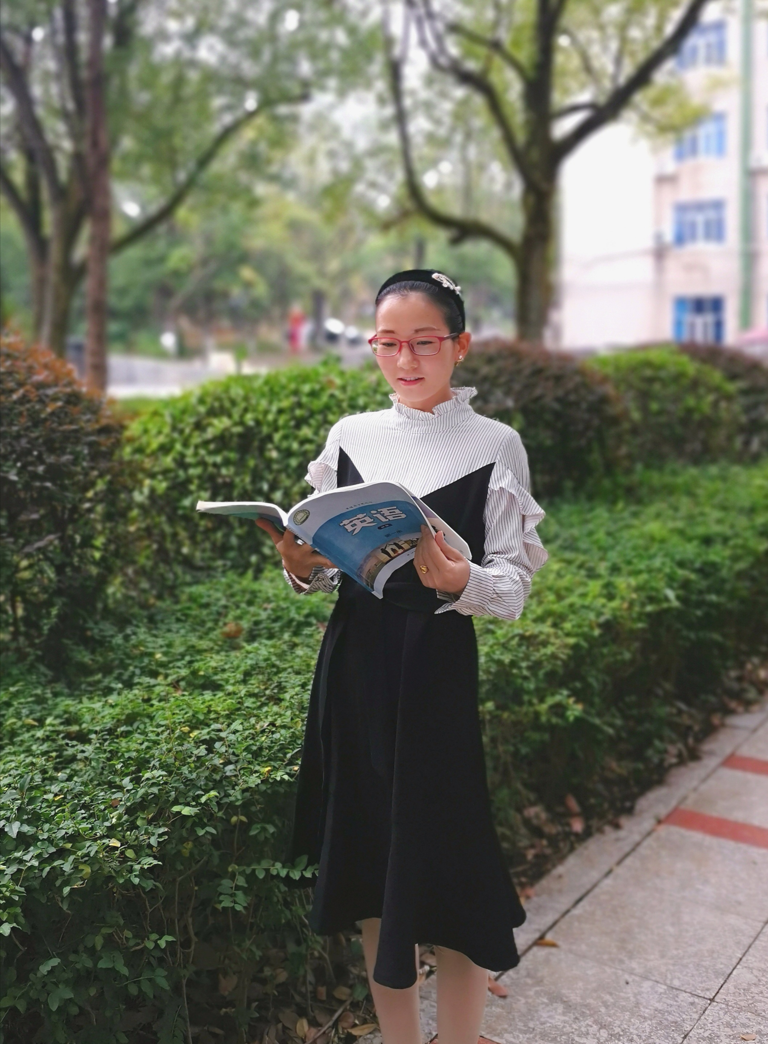
王爱娟
株洲市教学能手
株洲市教坛新秀
“一师一优课”活动部级优课
湖南省集体备课大赛一等奖
株洲市“建功新时代”教学竞赛二等奖

Slide 3
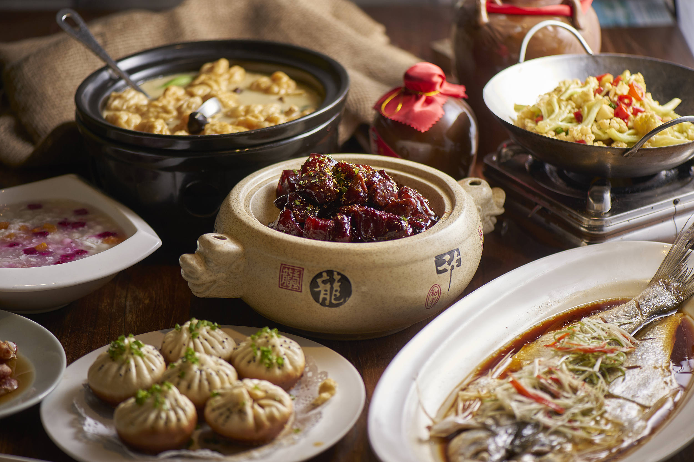
Step
1
Lead-in
What food do you usually have for lunch and dinner?
What’s your favorite food and can you introduce something about it?

Slide 4
Step
2
Global reading
1. Look through the text quickly
and answer these questions：
• What’s the genre of the text?
• What’s the main idea of the food critic’s blog?
Pay attention to the subtitles and pictures

Slide 5
2. Read the blog quickly and fill in the table.
Traditional Chinese foods | History |  | Popularity | Features |  |  | Benefits
 | Time | Background information |  | Ingredients | Making process | Flavor
Sichuan hot pot | started off in the late Qing Dynasty | the ______ and ______ climate | famous both in ________ and _____ | multiple _____, _______, meats and ______(e.g. __________, Sichuan peppers, __________ and red oil) | _______ various ingredients | hot | _________ a cold winter and ______________ rivers of sweat in summer; offer the best way to _____________
Nanjing salted duck | was praised in _______ __________________ | __________ _______ are perfect for raising ducks | the _____ _____ food export in Nanjing | _________ and white duck slices | _______, _______ boiling, and cooling | ____ and ____ | have __________ properties in hot summer
Cantonese dim sum | was served with tea in _________________________ | morning tea is ________ in the daily routine | quite _________ in the local | _________ dishes such as beef balls and rice noodles rolls | _______, boiling, _______ or frying | ____ | give people hours to have conversations about _________, family and ______________
damp
soups
boiling
heat up
foggy
vegetables
China
sauces
let loose
chillies
overseas
spring onions
relax with friends
countless
most
thin
salting
juicy
cooling
the late
waterways
famous
drying
Qing
salty
Dynasty
various
baking
essential
popular
steaming
light
the
business
mid-19th
century
pleasure

Slide 6
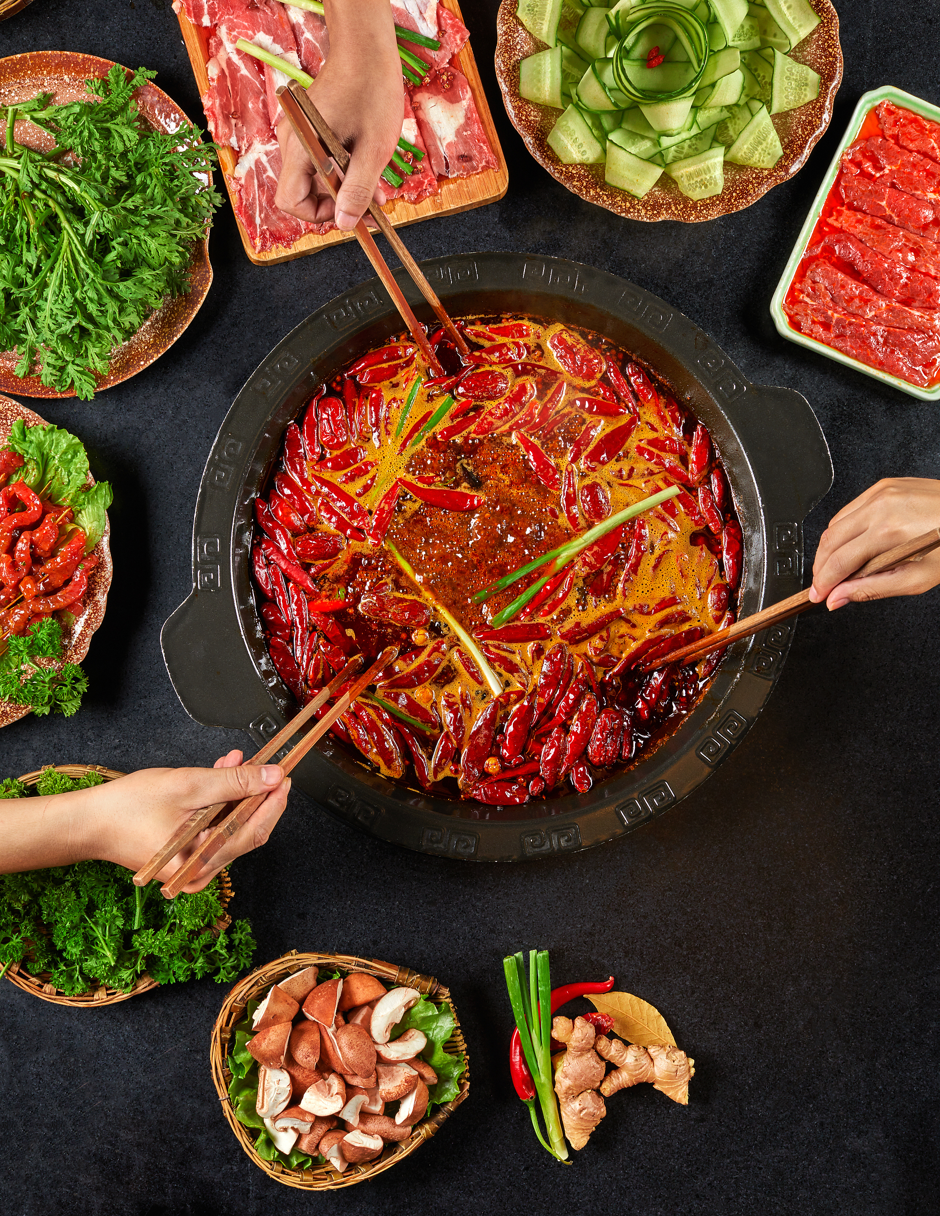
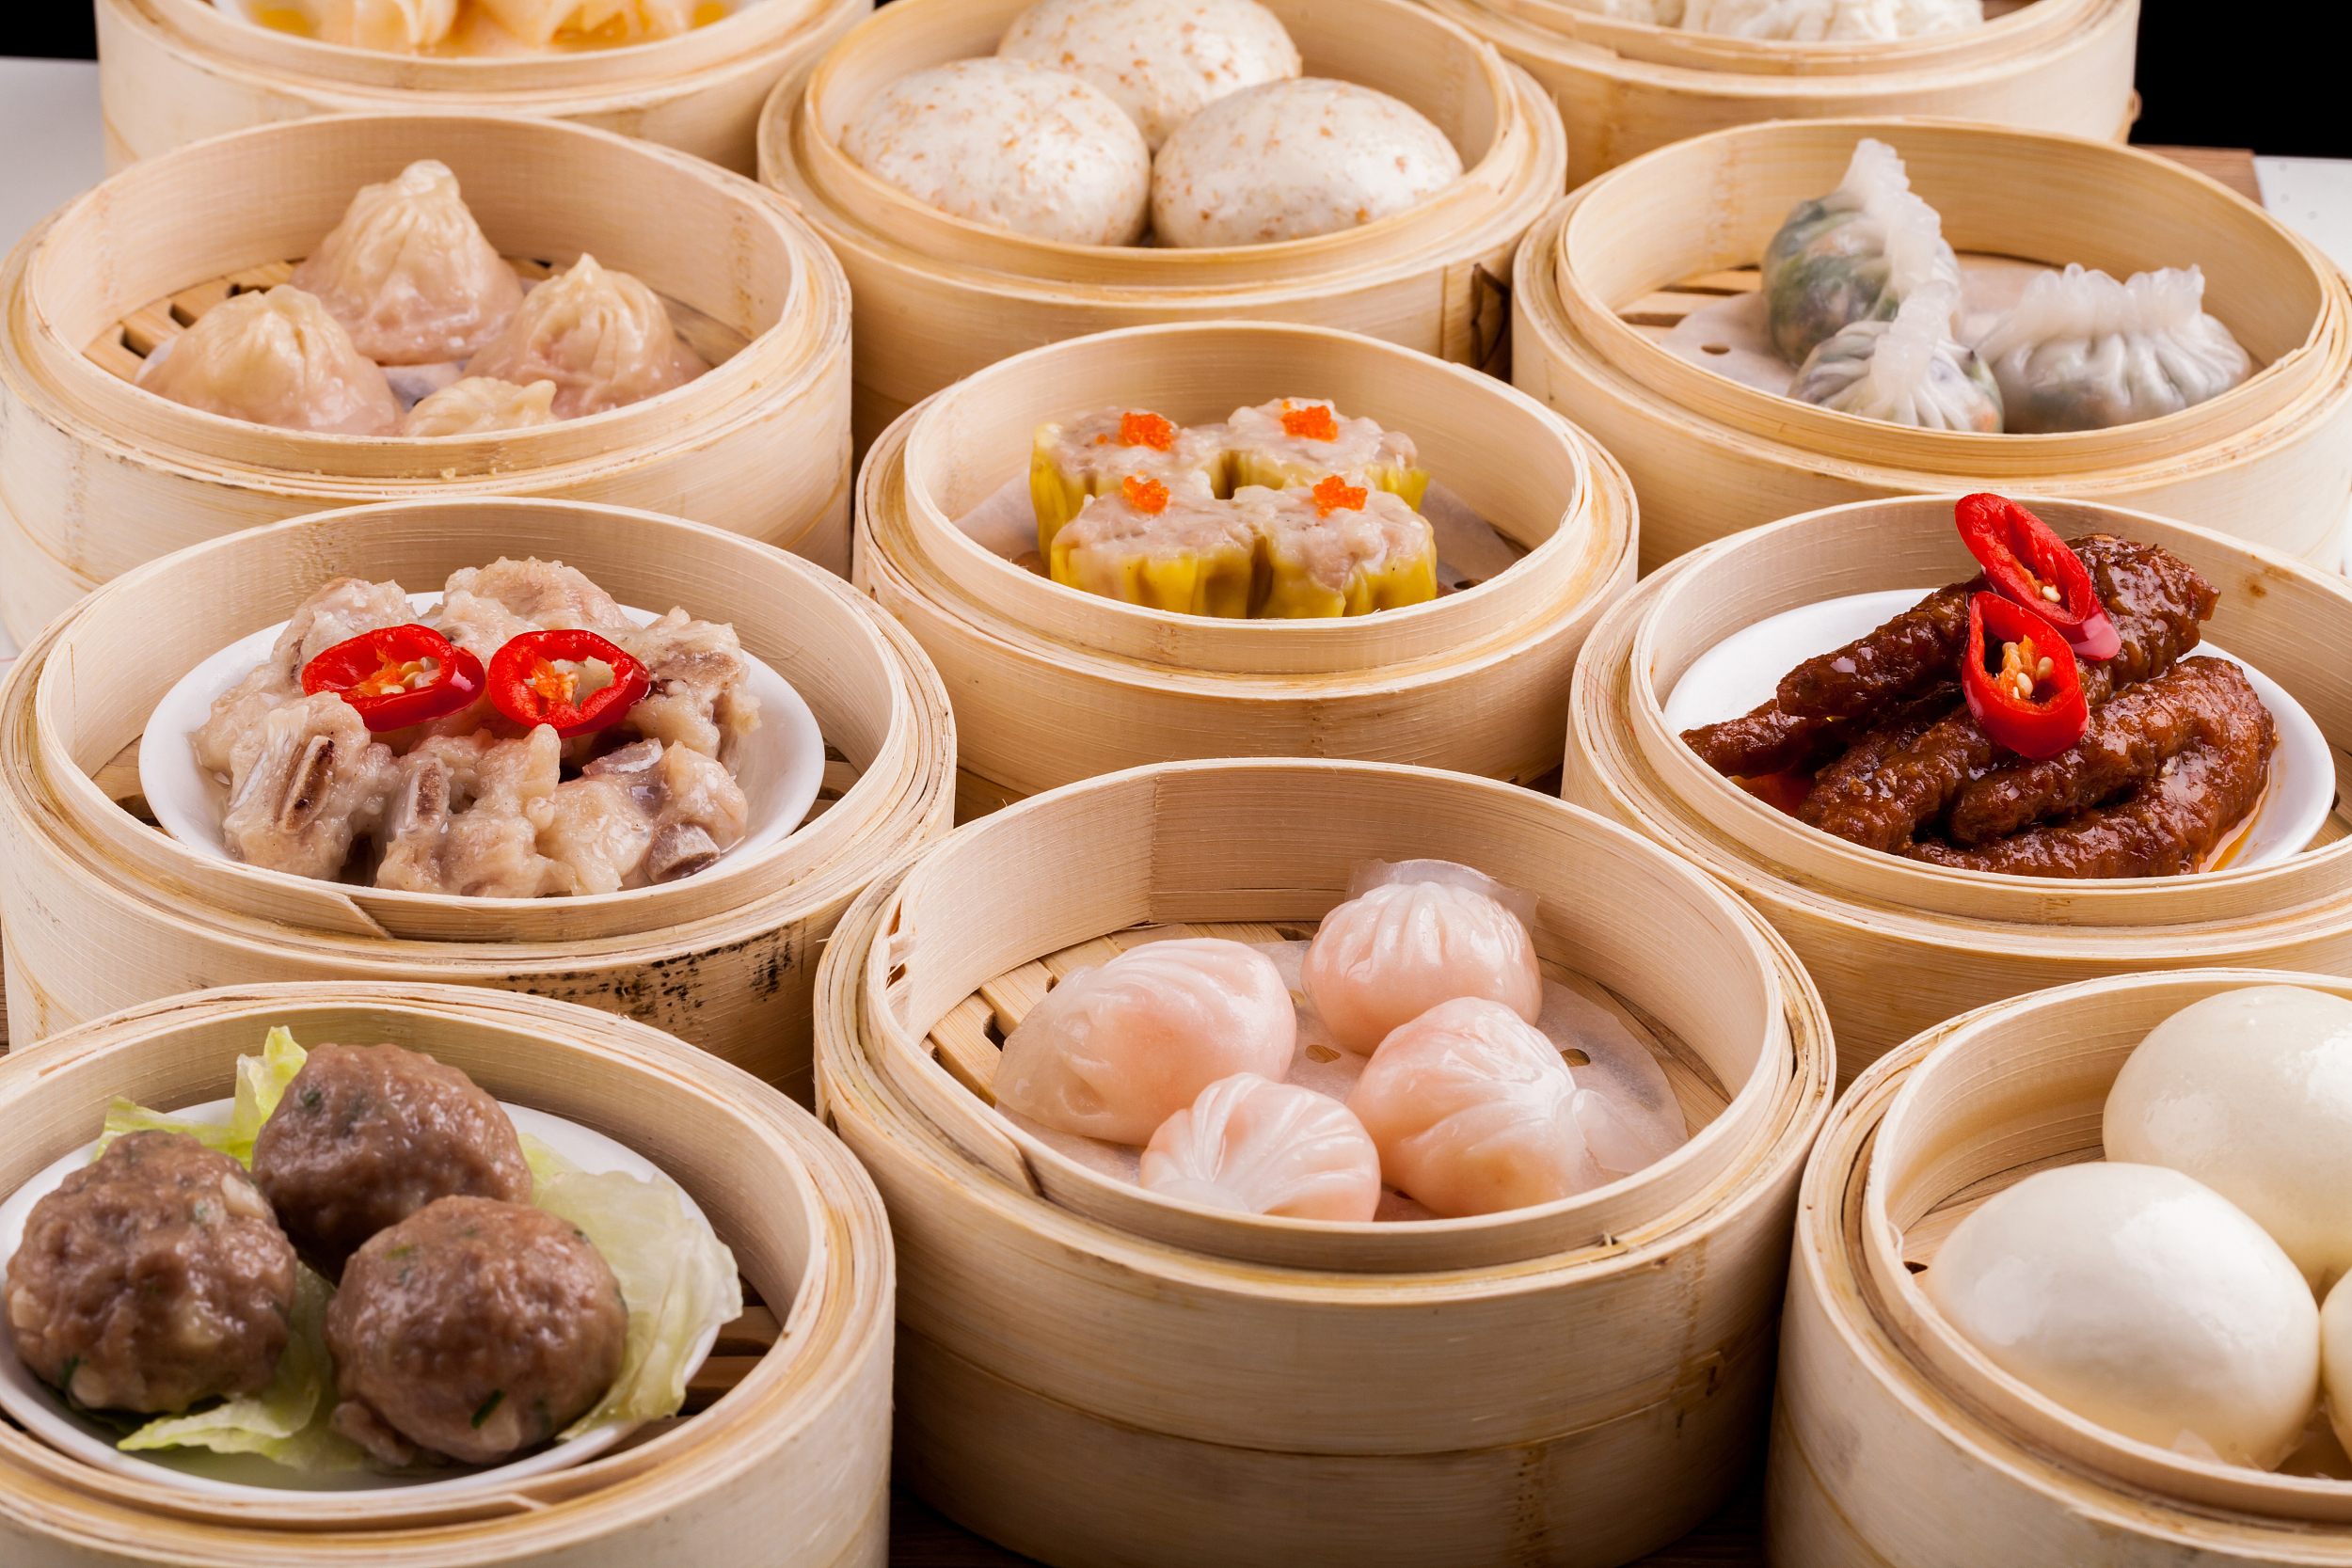
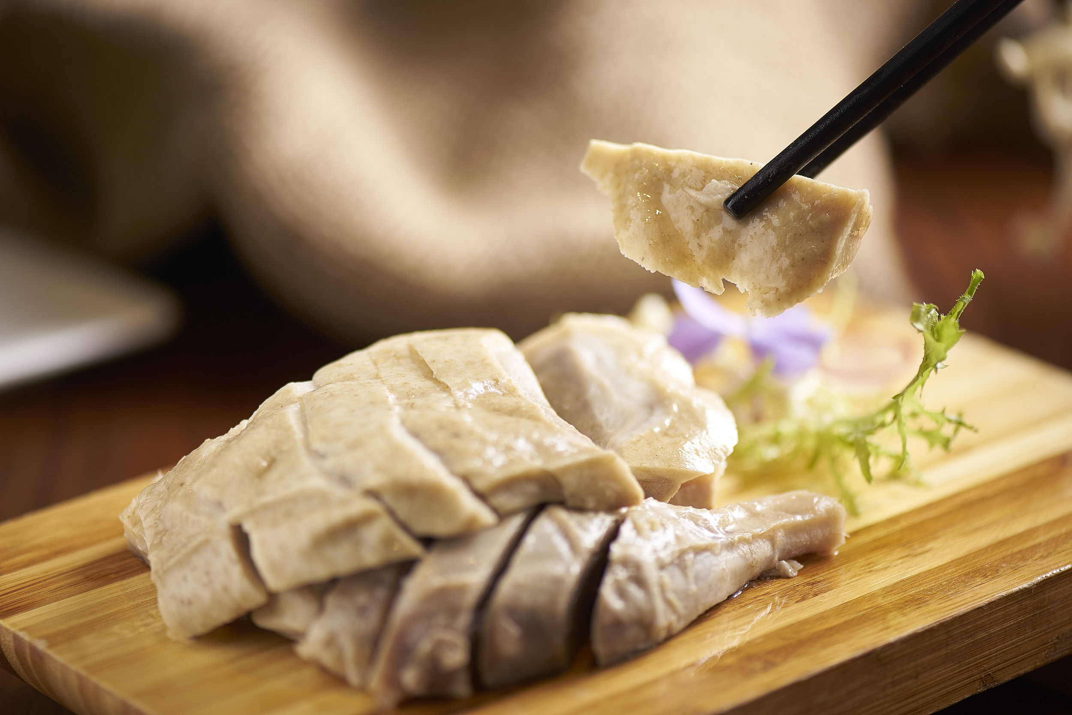
3. Introduce each of the three traditional Chinese foods by using your own words according to the table above.

Slide 7
Step
3
Writing a summary
• Write a summary of each of the three traditional Chinese foods in groups
• Different groups present their summaries

Slide 8
One possible version
Nanjing salted duck is juicy and salty and usually served in thin, white slices. Preparing it takes several days. The waterways around Nanjing are perfect for raising waterbirds, and salted duck was praised as the best dish in a local history book from the late Qing Dynasty. It is said to have cooling properties, thus appropriate for the hot summer months. People now eat salted duck all year round.

Slide 9
Step
4
Detailed reading
In the first sentence of the first paragraph, the author uses mouth-watering and let loose rivers of sweat to describe hot pots of Sichuan, what do you think of these descriptive words?
1
These descriptive words are so vivid and specific that transport readers to Sichuan to enjoy the hot pot. Also from these words, we can see the author’s love for the hot pot.

Slide 10
Read the last sentence of the first paragraph: The hot flavor quickened our laughter and conversation, making the meal the perfect way to relax with friends. How do you understand the word quickened?
2
Quickened means made something more active. From this sentence, we can know that people have more laughter and their conversations are more active when they enjoy Sichuan hot pot, so the meal really makes people relax themselves.

Slide 11
Read the sentence in line 30–31: A local history book from the late Qing Dynasty praised salted duck in particular, saying it was without equal. What can you know from the words without equal?
3
From the words without equal, we can know that in the late Qing Dynasty salted duck got the highest praise and people loved it very much.

Slide 12
Read this sentence in line 41–44: The concept took off, and today Guangzhou’s restaurants stimulate customers’ appetite with over a thousand offerings, each more delicate and delicious than the last. How do you understand the phrase took off ?
4
The phrase took off here means the concept, serving tea with a variety of light dishes, or dim sum, became popular very quickly. From this, we can know that Cantonese dim sum was welcome when it first became part of Cantonese life.

Slide 13
Step
5
Further reading
1. What does the food critic think of the three traditional Chinese foods? Please find out the supporting ideas.
The food critic really loves these foods.
Supporting ideas
① I instantly became a big fan of Sichuan hot pots and I’ll soon be back for more! (L19–20)
② It definitely hit the spot when I tried it, and it has become one of my personal favorites. (L34–35)
③ A single visit is not enough to appreciate everything, and I have a long list of dim sum I still need to try. (L50–51)

Slide 14
2. How do you like the three traditional Chinese foods in the text?

Slide 15
3. The three traditional Chinese foods are very popular, then what dish is popular in your hometown? Introduce it to a foreign traveller. Explain its popularity, history and features.
Tip: you can first draw a mind map according to the three aspects and then introduce the popular dish in your hometown.

Slide 16
Homework
1. Write a short passage to introduce a popular dish in your hometown and polish it.
2. Surf the Internet and find information about other traditional Chinese foods.

Slide 17
