Slide 1
Unit 2 Out of this world
Extended reading
唐德清 巢湖六中

Slide 2
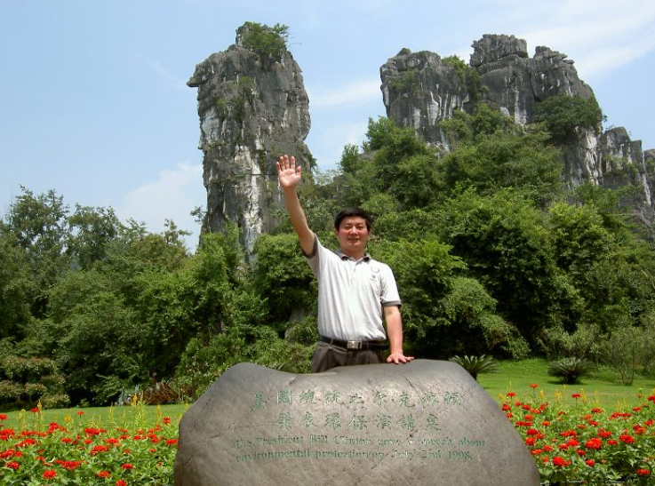
唐德清
巢湖市骨干教师
英语学科带头人、拔尖人才 参与教学参考用书编写
编写初高中教辅100余本

Slide 3
What’s the general idea of the text?
Reasons for space exploration
Why we explore
every first sentence of each paragraph is the subject sentence of the paragraph

Slide 4
five reasons for space exploration
our own instinct
learning about universe
civil application of technologies for space exploration
economic benefits
education and inspiration of the next generation

Slide 5
Reasons for space exploration
AP26
1 It is in our nature to explore.
2 It enables us to learn more about the origin, evolution, and likely future of the universe.
3 Technologies first researched and developed for space exploration can be used to solve some of the big problems on the Earth.
4 We profit economically from the space industry and it also creates jobs.
5 It educates and inspires the next generation.

Slide 6
economy, education, explore, discovery, investment, origination, learn, know
Why do we have interest in the ⁽¹⁾__________ of the space? Human desire drives us to know the ⁽²⁾________. As a result, we learn more about how the universe ⁽³⁾__________ and evolves. Then we can predict where it goes. With more about the universe ⁽⁴⁾________, we may find life in the outer space. As space technologies like shock absorbers and liquid hydrogen ⁽⁵⁾ ____________ and researched, we may solve some big problems on the Earth. Though we have ⁽⁶⁾________ the space industry hugely, the space industry can create jobs and benefit us ⁽⁷⁾____________. What’s more, the next generations ⁽⁸⁾____________ and inspired to participate in it.
exploration
unknown
originates
learnt
are discovered
invested
economically
are educated

Slide 7
BP26 Discussion 1
I agree with the author’s opinion. The exploration of space has brought us technologies that we use in our everyday lives.
I do not agree with the author’s opinion, because the focus should be on developing technology to keep the Earth and all its inhabitants safe and healthy

Slide 8
CP26 Discussion 2
expand our understanding of our role as humans
Past space exploration raised awareness of the need for global solutions to challenges.

Slide 9
CP26 Discussion 2
space exploration requires global cooperation
better understand the importance of working together to solve other problems on the Earth, such as poverty, hunger and war

Slide 10
1. origin
Definitions
1) n. starting-point; source
2) n. person’s parentage, background, etc.
Vocabulary web

original adj.

originally adv.
origin n.

Slide 11
2. frequency
Definitions
1) n. rate of occurrence or repetition of sth.
2) n. rate at which a sound wave or radio wave vibrates
Vocabulary web
frequency n.

frequent adj.

frequently adv.

Slide 12
3. motive
Definitions
1) n. that which causes sb. to act in a particular way; reason
2) adj. causing movement or action
Vocabulary web
motive adj.

motiveless adj.
motivate v.

motivation n.

Slide 13
4. investment
Definitions
n. the use of money to get a profit or to make a business activity successful, or the money that is used
Vocabulary web
invest v.

investment n.

investor n.
see: invent, invite

Slide 14
5. calculate
Definitions
v. work (sth.) out by using numbers or one’s judgement; estimate
Vocabulary web
calculate v.

calculation n.

Slide 15
6. coverage
Definitions
1) n. reporting of events, etc.
2) n. extent to which sth. is covered
Vocabulary web
cover v.

coverage n.
cover v.

uncover v.,
discover v.

Slide 16
7. mechanics
Definitions
1) n. science of motion and force; science of machinery
2) (pl.) n. (a) working parts (of sth.)
Vocabulary web

mechanics n.

mechanical adj.

machine n.
mechanically adv.

Slide 17
8. assistant
Definitions
n. someone whose job is just below the level of manager, etc.
Vocabulary web
assist v.

assistant n.,

assistance n.

Slide 18
9. incredibly
Definitions
1) adv. extremely, in an incredible manner
2) adv. in a way that is hard to believe
Vocabulary web
incredible adj.

incredibly adv.

Slide 19
Fill in the blanks with proper forms of the given words
1. There is a ________ (frequency) bus service into the centre of town every day.
1. frequent
2. They found their computers producing different results from exactly the same ________ (calculate).
2. calculation

Slide 20
Fill in the blanks with proper forms of the given words
3. Feeling depressed, she spoke ________ (mechanics), as if thinking of something else.
3. mechanically
4. An old woman was badly hurt in an apparently _______ (motive) attack from the mental patient.
4. motiveless

Slide 21
Fill in the blanks with proper forms of the given words
5. In the economic crisis, we did not even make enough money _______ (coverage) the cost of the food.
5. to cover
6. _______ (origin), we had intended to go to Italy, but then we won the trip to Greece.
6. Originally

Slide 22
Fill in the blanks with proper forms of the given words
7. The young nurse was very nervous when she _______ (assist) at her first operation.
7. assisted
8. The company _______ (invest) large amounts of funds and manpower for the development of new products in the past three years.
8. has invested

Slide 23
Fill in the blanks with proper forms of the given words
9. It seemed _______ (incredibly) that people would still want to play football during a war.
9. incredible
10. To select volunteers, you may need to understand the _______ (motivate) of the people you wish to attract.
10. motivation(s)

Slide 24
1. The reality is that space exploration is extremely difficult and dangerous, can take a very long time and costs a huge amount of money. (Para. 1)
________________________________________
___________________________
_____________________________
___________________________________
The reality is that…

Slide 25
2. Some people believe that while space exploration expands our understanding of the universe, it is a waste of the public purse and does nothing to enhance the quality of our lives here on the earth. (Para. 1)
____________
___________________________________________
Some people believe that…

Slide 26
3. With each space mission comes greater insight, thus motivating us to continue along the same path of adventure. (Para. 2)
_____
________________________________________________________
___________
Greater insight comes with each space mission…

Slide 27
4. The results of these space investigations have made major contributions to an understanding of the origin, evolution and likely future of the universe, such as planets, stars, and all other forms of matter and energy. (Para. 3)
The results…have made major contributions to an understanding …

Slide 28
5. It is through our research into space that we have confirmed that the Earth is round and that it orbits the Sun. (Para. 3)
_____________________________________
It…that (first ‘that’)…

Slide 29
6. With technologies first discovered and researched in space exploration, we can solve some of the big problems facing mankind, making our lives safer and easier. (Para. 4)
____________________________________________________________
_____________________
______________________________
______
…we can solve some of the big problems…

Slide 30
7. It is this cycle of inspiration from adult to child that keeps our thirst for knowledge alive and ensures that advances in space exploration and many other fields are always being made. (Para. 6)
________________________________________________
____
________________________________________________________________
_____________________
It…that (first ‘that’)…

Slide 31
Homework
1. Watch the micro lesson: How to write a summary. (Optional)
2. Finish off B1 in the workbook.

Slide 32
B1 in the workbook
1) What are the dangers on Mars?
1) To begin with, Mars is extremely cold. Also, its atmosphere is rich in carbon dioxide, so people will not be able to breathe. Still, with no magnetic field, Mars is exposed to much higher levels of radiation.

Slide 33
B1 in the workbook
2) Briefly summarize what life on Mars will be like. Include at least three aspects.
2) Since Mars has high levels of radiation, people in Martian cities will probably live underground at first and then above ground. Since it is expensive to send materials to Mars, Martian citizens will have to make good use of the planet’s resources and manufacture everything they need. Settlers will probably follow a vegan diet. Also, people there will not travel much because of the radiation. But they may take advantage of Mars’ low gravity and invent new sports to entertain themselves.

Slide 34
4) These local citizens now have to balance their traditional self-supporting hunting lifestyle with the lifestyle offered by the modern French Republic, which brings with it not only necessary state welfare, but also alcoholism, betrayal and even suicide.
A. The modern French lifestyle.
B. The self-supporting hunting.
C. The uncivilized hunting.
D. The French Republic.


